Slide 1
Bank Term Deposit Scheme
Data Analysis and Approach
to Model Building
by Anushree Tomar

Slide 2
Overview
The banks are moving with the pace of technology and incorporating different techniques to get the clients on-board. There are multiple marketing techniques in the market different banks are resorting to get people involved into different banking schemes. One such technique is phone calling the clients, getting their details and letting them know about the different schemes. It might require multiple calls to the same client to figure out if the client will be on-board or not. It is where Machine Learning can be incorporated and the result can be predicted based on the information received. This information will be valuable to pay more attention to the customers who might be willing to get on-board and be in their contact. The models can be trained on the data set and the banks can plan out a strategy which will be beneficial for them.

Slide 3
Dataset
The data sets are provided with the details of the campaign which we used to build a model which can predict if the client will say ‘yes’ or ‘no’ for the scheme. The scheme in question is term deposit and is the same for all the clients. If the client gets on-board, it is denoted with ‘yes’ and if he does not, it is denoted with ‘no’.

Slide 4
Data Description:
The data set consists of the 21 attributes along with their values. The term deposit is denoted with variable y. The data can be understood in the 4 parts:
Bank client data attributes
Related with the last contact of the current campaign attributes
Other Attributes
Social and Economic Context Attributes

Slide 5
1. Bank client data attributes
Attribute | Values
key | 1, 2. 3, 4….
age | numeric
job | type of job (categorical:‘admin.’,‘blue-collar’,‘entrepreneur’,‘housemaid’,
 | ‘management’,‘retired’,‘self-employed’,‘services’,‘student’,‘technician’,‘unemployed’,‘unknown’)
marital | marital status (categorical: ‘divorced’,‘married’,‘single’,‘unknown’;
 | note: ‘divorced’ means divorced or widowed)
education | categorical: ‘basic.4y’,‘basic.6y’,‘basic.9y’,‘high.school’,‘illiterate’,
 | ‘professional.course’,‘university.degree’,‘unknown’
default | has credit in default? (categorical: ‘no’,‘yes’,‘unknown’)
housing | has housing loan? (categorical: ‘no’, ‘yes’, ‘unknown’)
loan | has personal loan? (categorical: ‘no’,‘yes’,‘unknown’)

Slide 6
2. Related with the last contact of the current campaign attributes
Attributes | Values
contact | contact communication type (categorical: ‘cellular’,‘telephone’)
month | last contact month of year (categorical: ‘jan’, ‘feb’, ‘mar’, …, ‘nov’, ‘dec’)
day_of_week | last contact day of the week (categorical: ‘mon’,‘tue’,‘wed’,‘thu’,‘fri’)
duration | last contact duration, in seconds (numeric)
*Note*: duration attribute highly affects the output target (e.g., if duration=0 then y='no'). Yet, the duration is not known before a call is performed. Also, after the end of the call y is obviously known.

Slide 7
3. Other Attributes
Attributes | Values
campaign | number of contacts performed during this campaign and for this client (numeric, includes last contact)
pdays | number of days that passed by after the client was last contacted from a previous campaign
 | (numeric; 999 means client was not previously contacted)
previous | number of contacts performed before this campaign and for this client (numeric)
poutcome | outcome of the previous marketing campaign (categorical: ‘failure’,‘nonexistent’,‘success’)

Slide 8
4. Social and Economic Context Attributes
Attributes | Values
emp.var.rate | employment variation rate - quarterly indicator (numeric)
cons.price.idx | consumer price index - monthly indicator (numeric)
cons.conf.idx | consumer confidence index - monthly indicator (numeric)
euribor3m | euribor 3 month rate - daily indicator (numeric)
nr.employed | number of employees - quarterly indicator (numeric)

Slide 9
Data Dictionary
Here’s a brief version of what you’ll find in the data description file.
Variable | Description
key | Unique Key
y | If the client would say yes or no for the deposit scheme

Slide 10
Data Insights
Import Libraries
First we import libraries required for Exploratory Data Analysis.
library(data.table) library(DataExplorer) library(ggplot2) library(scales) library(corrplot)
Import Files
Let’s Analyse train and test data sets:-

Slide 11
Observing Data
Train Dataset
## key age job marital education default housing loan ## 1: 444 45 management married university.degree no yes no ## 2: 445 34 admin. married basic.9y no no no ## 3: 446 47 blue-collar married unknown unknown no no ## 4: 447 42 technician married professional.course no no no ## 5: 448 57 technician married basic.4y unknown no yes ## 6: 449 57 technician married basic.4y unknown no no ## contact month day_of_week duration campaign pdays previous poutcome ## 1: telephone may tue 140 1 999 0 nonexistent ## 2: telephone may tue 175 1 999 0 nonexistent ## 3: telephone may tue 136 1 999 0 nonexistent ## 4: telephone may tue 1623 1 999 0 nonexistent ## 5: telephone may tue 50 1 999 0 nonexistent ## 6: telephone may tue 101 1 999 0 nonexistent ## emp.var.rate cons.price.idx cons.conf.idx euribor3m nr.employed y ## 1: 1.1 93.994 -36.4 4.857 5191 no ## 2: 1.1 93.994 -36.4 4.857 5191 no ## 3: 1.1 93.994 -36.4 4.857 5191 no ## 4: 1.1 93.994 -36.4 4.857 5191 yes ## 5: 1.1 93.994 -36.4 4.857 5191 no ## 6: 1.1 93.994 -36.4 4.857 5191 no
Test Dataset
## key age job marital education default housing loan contact month ## 1: 1 56 housemaid married basic.4y no no no telephone may ## 2: 2 57 services married high.school unknown no no telephone may ## 3: 3 37 services married high.school no yes no telephone may ## 4: 4 40 admin. married basic.6y no no no telephone may ## 5: 5 56 services married high.school no no yes telephone may ## 6: 6 45 services married basic.9y unknown no no telephone may ## day_of_week duration campaign pdays previous poutcome emp.var.rate ## 1: mon 261 1 999 0 nonexistent 1.1 ## 2: mon 149 1 999 0 nonexistent 1.1 ## 3: mon 226 1 999 0 nonexistent 1.1 ## 4: mon 151 1 999 0 nonexistent 1.1 ## 5: mon 307 1 999 0 nonexistent 1.1 ## 6: mon 198 1 999 0 nonexistent 1.1 ## cons.price.idx cons.conf.idx euribor3m nr.employed ## 1: 93.994 -36.4 4.857 5191 ## 2: 93.994 -36.4 4.857 5191 ## 3: 93.994 -36.4 4.857 5191 ## 4: 93.994 -36.4 4.857 5191 ## 5: 93.994 -36.4 4.857 5191 ## 6: 93.994 -36.4 4.857 5191

Slide 12
Check for missing value
Train Dataset
## rows columns discrete_columns continuous_columns all_missing_columns ## 1: 4170 22 11 11 0 ## total_missing_values complete_rows total_observations memory_usage ## 1: 0 4170 91740 463032
Test Dataset
## rows columns discrete_columns continuous_columns all_missing_columns ## 1: 37018 21 10 11 0 ## total_missing_values complete_rows total_observations memory_usage ## 1: 0 37018 777378 3862416
we checked train and test dataset for missing values but fortunately the data is cleaned.

Slide 13
Find Duplicates in the data
Dimension of the data
## [1] 4170 22
Find Duplicates
## Empty data.table (0 rows and 22 cols): key,age,job,marital,education,default...
There is no duplicate records in the dataset.

Slide 14
Data Visualization

Slide 15
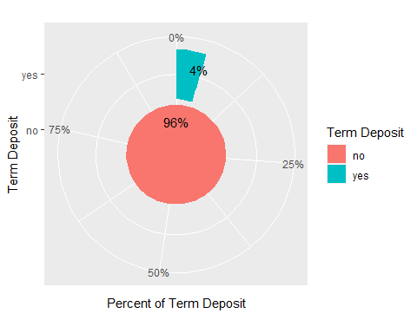
Percent distribution of target variable

Slide 16
As you can see that 96% of the clients are not interested in the Term Deposit Scheme.But the Bank is interested in those clients who are interested in the scheme from the business point of view so we need to upsample the lower class in the dataset before model building.

Slide 17
Basic statistics

Slide 18
Exploratory Data Analysis Summary Stats of train data
## key age job marital ## Min. : 444 Min. :20.00 blue-collar :1059 divorced: 465 ## 1st Qu.: 4407 1st Qu.:33.00 admin. : 962 married :2786 ## Median :10770 Median :39.00 technician : 701 single : 906 ## Mean :11331 Mean :40.59 services : 411 unknown : 13 ## 3rd Qu.:11812 3rd Qu.:47.00 management : 328 ## Max. :24452 Max. :60.00 entrepreneur: 178 ## (Other) : 531 ## education default housing loan ## basic.4y : 489 no :2943 no :2067 no :3470 ## basic.6y : 247 unknown:1227 unknown: 134 unknown: 134 ## basic.9y : 671 yes :1969 yes : 566 ## high.school : 930 ## professional.course: 531 ## university.degree :1129 ## unknown : 173 ## contact month day_of_week duration campaign ## cellular : 885 aug: 693 fri: 947 Min. : 4.0 Min. : 1.000 ## telephone:3285 jun:2198 mon:1027 1st Qu.: 86.0 1st Qu.: 1.000 ## may:1044 thu: 600 Median : 157.0 Median : 2.000 ## nov: 235 tue: 835 Mean : 241.8 Mean : 3.172 ## wed: 761 3rd Qu.: 294.0 3rd Qu.: 3.000 ## Max. :3078.0 Max. :56.000 ## ## pdays previous poutcome emp.var.rate ## Min. : 3.0 Min. :0.00000 failure : 42 Min. :-0.10 ## 1st Qu.:999.0 1st Qu.:0.00000 nonexistent:4125 1st Qu.: 1.10 ## Median :999.0 Median :0.00000 success : 3 Median : 1.40 ## Mean :998.3 Mean :0.01079 Mean : 1.24 ## 3rd Qu.:999.0 3rd Qu.:0.00000 3rd Qu.: 1.40 ## Max. :999.0 Max. :1.00000 Max. : 1.40 ## ## cons.price.idx cons.conf.idx euribor3m nr.employed y ## Min. :93.20 Min. :-42.00 Min. :4.191 Min. :5191 no :3985 ## 1st Qu.:93.99 1st Qu.:-41.80 1st Qu.:4.858 1st Qu.:5191 yes: 185 ## Median :94.47 Median :-41.80 Median :4.959 Median :5228 ## Mean :94.11 Mean :-39.51 Mean :4.892 Mean :5217 ## 3rd Qu.:94.47 3rd Qu.:-36.40 3rd Qu.:4.961 3rd Qu.:5228 ## Max. :94.47 Max. :-36.10 Max. :4.966 Max. :5228 ##

Slide 19
Summary Stats of test data
## key age job marital ## Min. : 1 Min. :17.00 admin. :9460 divorced: 4147 ## 1st Qu.:12497 1st Qu.:32.00 blue-collar:8195 married :22142 ## Median :22445 Median :38.00 technician :6042 single :10662 ## Mean :21638 Mean :39.96 services :3558 unknown : 67 ## 3rd Qu.:31934 3rd Qu.:47.00 management :2596 ## Max. :41188 Max. :98.00 retired :1609 ## (Other) :5558 ## education default housing loan ## university.degree :11039 no :29645 no :16555 no :30480 ## high.school : 8585 unknown: 7370 unknown: 856 unknown: 856 ## basic.9y : 5374 yes : 3 yes :19607 yes : 5682 ## professional.course: 4712 ## basic.4y : 3687 ## basic.6y : 2045 ## (Other) : 1576 ## contact month day_of_week duration ## cellular :25259 may :12725 fri:6880 Min. : 0.0 ## telephone:11759 jul : 7174 mon:7487 1st Qu.: 104.0 ## aug : 5485 thu:8023 Median : 182.0 ## nov : 3866 tue:7255 Mean : 260.1 ## jun : 3120 wed:7373 3rd Qu.: 322.0 ## apr : 2632 Max. :4918.0 ## (Other): 2016 ## campaign pdays previous poutcome ## Min. : 1.000 Min. : 0.0 Min. :0.0000 failure : 4210 ## 1st Qu.: 1.000 1st Qu.:999.0 1st Qu.:0.0000 nonexistent:31438 ## Median : 2.000 Median :999.0 Median :0.0000 success : 1370 ## Mean : 2.499 Mean :958.4 Mean :0.1912 ## 3rd Qu.: 3.000 3rd Qu.:999.0 3rd Qu.:0.0000 ## Max. :43.000 Max. :999.0 Max. :7.0000 ## ## emp.var.rate cons.price.idx cons.conf.idx euribor3m ## Min. :-3.40000 Min. :92.20 Min. :-50.80 Min. :0.634 ## 1st Qu.:-1.80000 1st Qu.:93.08 1st Qu.:-42.70 1st Qu.:1.327 ## Median : 1.10000 Median :93.44 Median :-42.00 Median :4.856 ## Mean :-0.04861 Mean :93.52 Mean :-40.61 Mean :3.478 ## 3rd Qu.: 1.40000 3rd Qu.:93.99 3rd Qu.:-36.40 3rd Qu.:4.961 ## Max. : 1.40000 Max. :94.77 Max. :-26.90 Max. :5.045 ## ## nr.employed ## Min. :4964 ## 1st Qu.:5099 ## Median :5191 ## Mean :5161 ## 3rd Qu.:5228 ## Max. :5228 ##
.
Attributes education,default and month have new levels in the test data

Slide 20
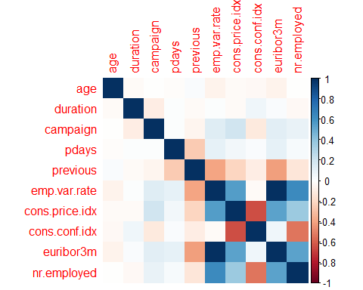
Correlation of Numeric/Integer attributes
Find the correlation among continuous variable

Slide 21
we found no strong Positive and negative relationship between the variables in the Correlation plot except euribor3m(euribor 3 month rate) and emp.var.rate(employment variation rate) which are Positively correlated to each other.while cons.price.idx(consumer price index) and nr.employed are moderately(+) correlated to emp.var.rate.cons.conf.idx and cons.price.idx are moderately(-) correlated.

Slide 22
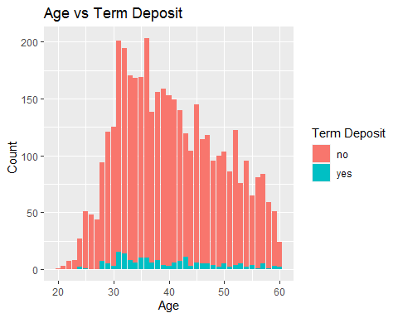
Distribution of the Term Deposit by age
Lets analyse which age group is accepting or rejecting the Term Deposit scheme:-

Slide 23
As you can see, the minimum age of the clients contacted by the bank is 20 years and the maximum is 60 years. From the above graph you can visualize that most of the clients who accepted the Term Deposit scheme is lie mostly between 30 years to 50 years.

Slide 24
Distribution of Age and Job by accepted Term Deposit scheme
Let’s go more deeper into it where we will find the clients who accepted the term deposit scheme belong to which kind of Job.
## key age job marital education default housing loan ## 1: 447 42 technician married professional.course no no no ## 2: 470 42 management married university.degree no no no ## 3: 1810 43 admin. married university.degree unknown yes no ## 4: 1820 44 blue-collar single basic.6y unknown yes no ## 5: 2003 59 management married university.degree no no no ## 6: 2040 24 services single high.school no no no ## contact month day_of_week duration campaign pdays previous poutcome ## 1: telephone may tue 1623 1 999 0 nonexistent ## 2: telephone may tue 1677 1 999 0 nonexistent ## 3: telephone may fri 2016 2 999 0 nonexistent ## 4: telephone may fri 665 2 999 0 nonexistent ## 5: telephone may mon 460 5 999 0 nonexistent ## 6: telephone may mon 757 2 999 0 nonexistent ## emp.var.rate cons.price.idx cons.conf.idx euribor3m nr.employed y ## 1: 1.1 93.994 -36.4 4.857 5191 yes ## 2: 1.1 93.994 -36.4 4.857 5191 yes ## 3: 1.1 93.994 -36.4 4.855 5191 yes ## 4: 1.1 93.994 -36.4 4.855 5191 yes ## 5: 1.1 93.994 -36.4 4.857 5191 yes ## 6: 1.1 93.994 -36.4 4.857 5191 yes

Slide 25
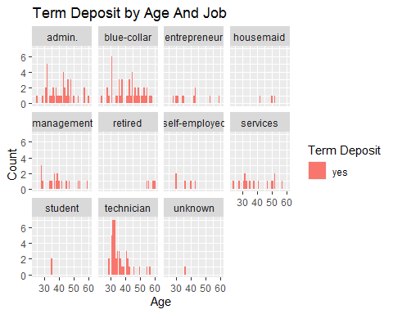
From the above graph we can assume that our future Potential clients may belong to blue-collar,technician,admin, and management(decreasing order) type of job .

Slide 26
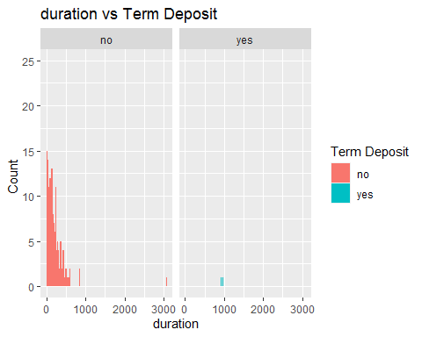
Distribution of the Term Deposit by duration
Now analyse the affect of duration on Term Deposit scheme.

Slide 27
From the graph it is clear that clients who contacted for a very short duration belong to No category. As the duration can be obtained after the phone call is performed it is obvious that duration is highly correlated to the target variable. So that at the time of Feature engineering we can drop this variable.

Slide 28
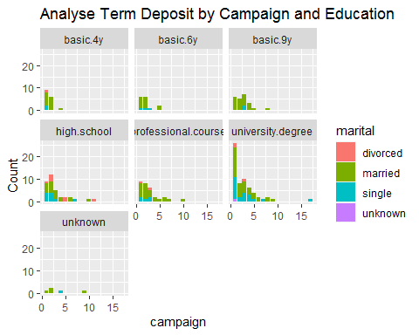
Distribution of campaign and education by Accepted Term Deposit
Let’s analyse how many contacts performed during this campaign.

Slide 29
Graphical analysis saying that number of contacts performed on clients during campaign are having mostly university.degree followed by high.school and professional.course degree. and most of the clients are married as usual.

Slide 30
Relationship of Loan with accepted Target scheme
Now analyse the status of loan and credit in default of the clients who accepted the scheme- From the graph it is clear that most of the clients who accepted the term deposit scheme have no credit in default.
secondly fewer number of clients have personal loans.
Thirdly there are an equal number of clients with or without housing loans.

Slide 31
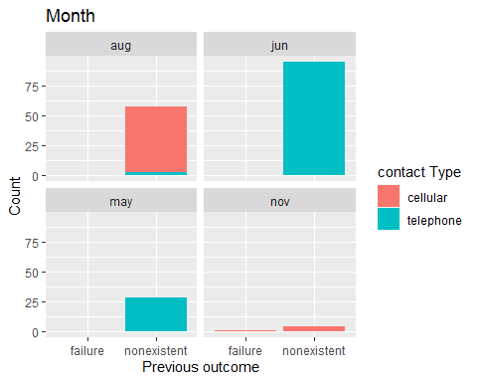
Relationship of previous outcome with accepted Target scheme

Slide 32
Most of the clients belong to nonexistent categories who accepted the Term deposit scheme and contacted by telephone. secondly they were contacted in the month of jun followed by aug and may.

Slide 33
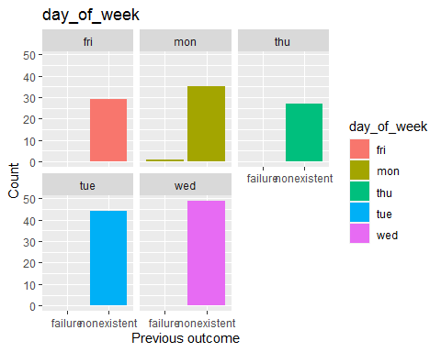
previous outcome with in day_of_week and accepted Target scheme

Slide 34
The result of the previous outcome suggests that clients mostly belong to nonexistent categories and their count is more on ‘wed’ followed by tue and mon.

Slide 35
Approach To create Predictive Model
Feature Engineering
Our next step is to perform Feature Engineering on the data so that we can get a best performing model.
Steps involved in Feature Engineering:-
Grouping of age attribute
Drop duration column
Standardize numeric data
Balancing the data by smote technique
Re-leveling the train Data

Slide 36
Grouping(Binning) of age attribute
In this step we will create groups of the age attribute and label them as 0-4, 5-9, 10-14 and so on.
## key age job marital education default housing loan ## 1: 444 45-49 management married university.degree no yes no ## 2: 445 30-34 admin. married basic.9y no no no ## 3: 446 45-49 blue-collar married unknown unknown no no ## 4: 447 40-44 technician married professional.course no no no ## 5: 448 55-59 technician married basic.4y unknown no yes ## 6: 449 55-59 technician married basic.4y unknown no no ## contact month day_of_week campaign pdays previous poutcome emp.var.rate ## 1: telephone may tue 1 999 0 nonexistent 1.1 ## 2: telephone may tue 1 999 0 nonexistent 1.1 ## 3: telephone may tue 1 999 0 nonexistent 1.1 ## 4: telephone may tue 1 999 0 nonexistent 1.1 ## 5: telephone may tue 1 999 0 nonexistent 1.1 ## 6: telephone may tue 1 999 0 nonexistent 1.1 ## cons.price.idx cons.conf.idx euribor3m nr.employed y ## 1: 93.994 -36.4 4.857 5191 no ## 2: 93.994 -36.4 4.857 5191 no ## 3: 93.994 -36.4 4.857 5191 no ## 4: 93.994 -36.4 4.857 5191 yes ## 5: 93.994 -36.4 4.857 5191 no ## 6: 93.994 -36.4 4.857 5191 no

Slide 37
Standardize the data
In this step we Standardize numerical variables to the same range where mean and standard deviation of all numerical variables will be 0 and 1 respectively.
## key age job marital education default housing loan ## 1: 444 45-49 management married university.degree no yes no ## 2: 445 30-34 admin. married basic.9y no no no ## 3: 446 45-49 blue-collar married unknown unknown no no ## 4: 447 40-44 technician married professional.course no no no ## 5: 448 55-59 technician married basic.4y unknown no yes ## 6: 449 55-59 technician married basic.4y unknown no no ## contact month day_of_week campaign pdays previous poutcome ## 1: telephone may tue -0.546413 0.02682852 -0.1044341 nonexistent ## 2: telephone may tue -0.546413 0.02682852 -0.1044341 nonexistent ## 3: telephone may tue -0.546413 0.02682852 -0.1044341 nonexistent ## 4: telephone may tue -0.546413 0.02682852 -0.1044341 nonexistent ## 5: telephone may tue -0.546413 0.02682852 -0.1044341 nonexistent ## 6: telephone may tue -0.546413 0.02682852 -0.1044341 nonexistent ## emp.var.rate cons.price.idx cons.conf.idx euribor3m nr.employed y ## 1: -0.3987949 -0.2570681 1.138698 -0.1965098 -1.553122 no ## 2: -0.3987949 -0.2570681 1.138698 -0.1965098 -1.553122 no ## 3: -0.3987949 -0.2570681 1.138698 -0.1965098 -1.553122 no ## 4: -0.3987949 -0.2570681 1.138698 -0.1965098 -1.553122 yes ## 5: -0.3987949 -0.2570681 1.138698 -0.1965098 -1.553122 no ## 6: -0.3987949 -0.2570681 1.138698 -0.1965098 -1.553122 no
## pdays emp.var.rate ## Min. :-37.28979 Min. :-3.8083 ## 1st Qu.: 0.02683 1st Qu.:-0.3988 ## Median : 0.02683 Median : 0.4536 ## Mean : 0.00000 Mean : 0.0000 ## 3rd Qu.: 0.02683 3rd Qu.: 0.4536 ## Max. : 0.02683 Max. : 0.4536
## [1] "standard deviation of pdays = 1"

Slide 38
Creating Balanced data
## age job marital education default housing loan contact ## 1: 45-49 management married university.degree no yes no telephone ## 2: 30-34 admin. married basic.9y no no no telephone ## 3: 45-49 blue-collar married unknown unknown no no telephone ## 4: 40-44 technician married professional.course no no no telephone ## 5: 55-59 technician married basic.4y unknown no yes telephone ## 6: 55-59 technician married basic.4y unknown no no telephone ## month day_of_week duration campaign pdays previous poutcome emp.var.rate ## 1: may tue 140 1 999 0 nonexistent 1.1 ## 2: may tue 175 1 999 0 nonexistent 1.1 ## 3: may tue 136 1 999 0 nonexistent 1.1 ## 4: may tue 1623 1 999 0 nonexistent 1.1 ## 5: may tue 50 1 999 0 nonexistent 1.1 ## 6: may tue 101 1 999 0 nonexistent 1.1 ## cons.price.idx cons.conf.idx euribor3m nr.employed y ## 1: 93.994 -36.4 4.857 5191 no ## 2: 93.994 -36.4 4.857 5191 no ## 3: 93.994 -36.4 4.857 5191 no ## 4: 93.994 -36.4 4.857 5191 yes ## 5: 93.994 -36.4 4.857 5191 no ## 6: 93.994 -36.4 4.857 5191 no
## ## no yes ## 3985 3985

Slide 39
Re-Leveling of Attributes
We found new levels in the test data so that to solve our problem we releveled the train data as a test dataset.
Check levels after Re-leveling
## [1] "education levels in balanced_data and test dataset"
## [1] "basic.4y" "basic.6y" "basic.9y" ## [4] "high.school" "illiterate" "professional.course" ## [7] "university.degree" "unknown"
## [1] "basic.4y" "basic.6y" "basic.9y" ## [4] "high.school" "illiterate" "professional.course" ## [7] "university.degree" "unknown"

Slide 40
Model Building
After Feature Engineering our next step is to partition the data into train data and test data in the ratio of 70/30.

Slide 41
Machine learning algorithms
Classification algorithms we applied in the development of Bank term deposit Scheme with Feature Engineering steps mentioned above includes:-
Random Forest(Auto ML-h2o)
Decision tree
XGboost
CatBoost
Final Model Selection
1-After comparing the results of all models we find the Decision tree model and the `CatBoost’ model showing similar scores on Leaderboard.
2-Our Final Model is Performing very well with Binning of Age attributes,Re-leveling and with Balanced data.
3-Droping of duration column and scaling of the numerical columns is not improving the score of the model.
Evaluation Matric
Final Model selection done by Accuracy Score

Slide 42
Submission
Files included in the submission are:-
1 Source code
Data Analysis and Approach
Predictive Model
2 Model saved
data_tree_relevel4.rds
model(Catboost Model)
XGboost_new2_mod.rds
3 Output file
relevel_4.csv

Slide 43
Thank You,
Anushree Tomar

